Slide 1

Conservation equations: we really really love ‘em!
For momentum: lots of massaging to beat RHS terms down
For ‘warmth’: have to account for compression & expansion (adiabatic Temperature warming/cooling in the absence of actual diabatic or latent heating)

Slide 2
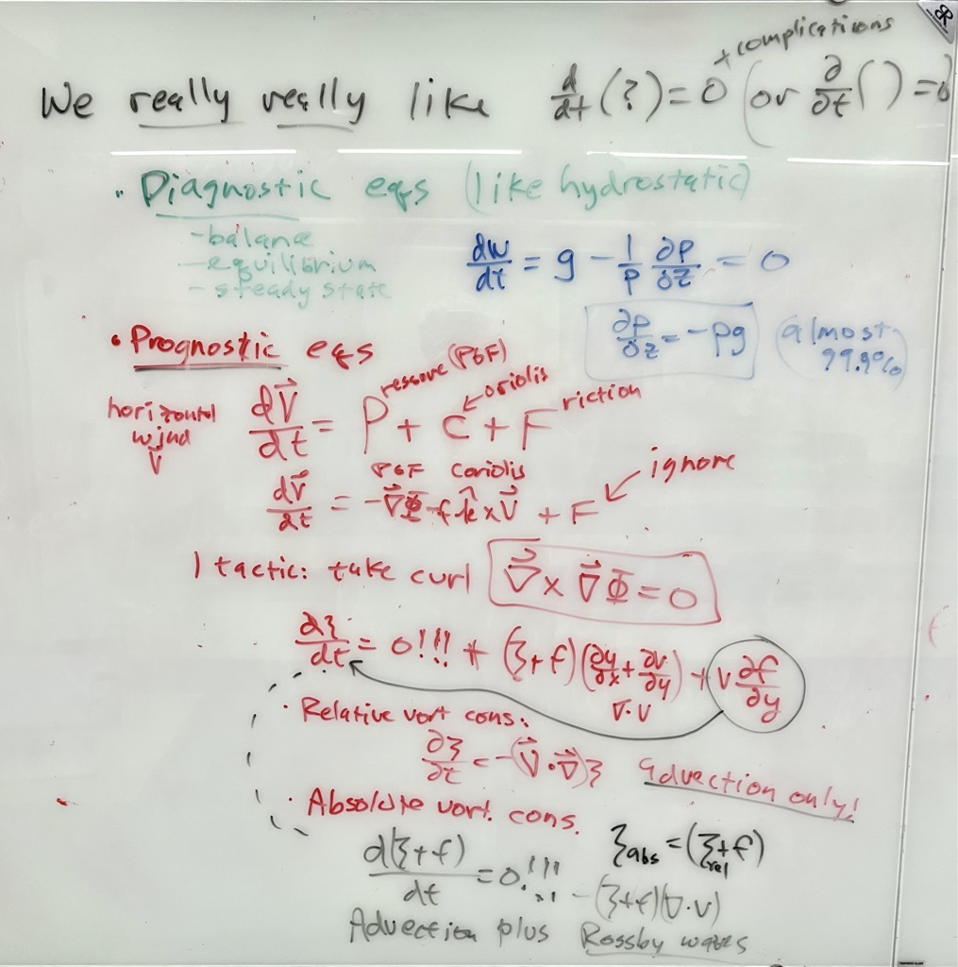
x

Slide 3
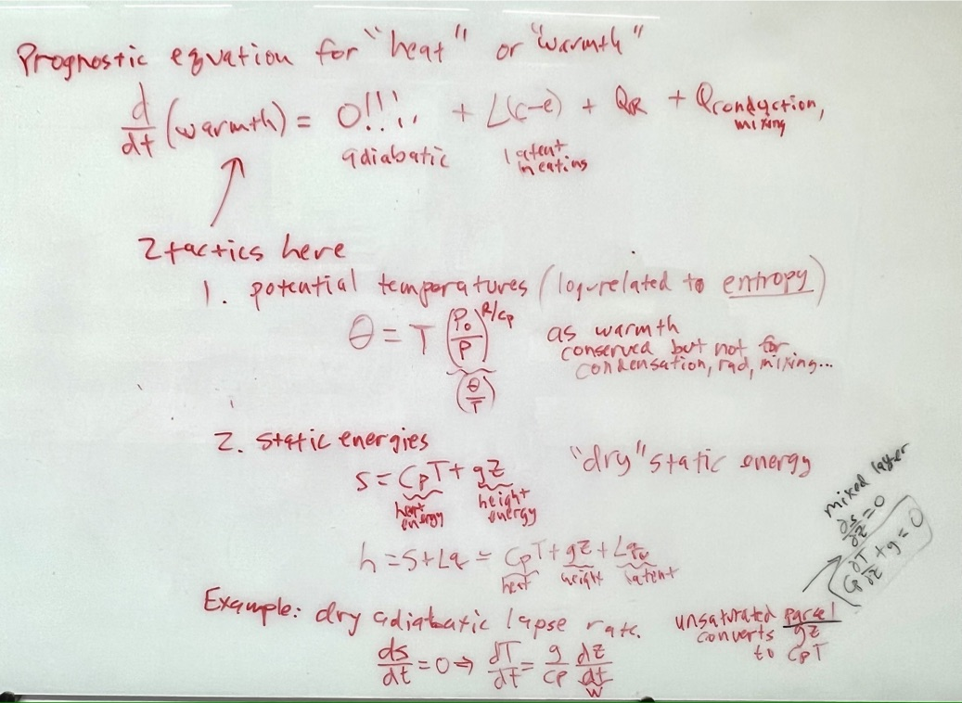
x

Slide 4
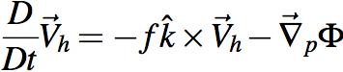
Momentum: not conserved enough
To predict vector momentum V_{h}, need Φ
But that drags thermo into our equation set
must predict T for thickness for heights Z
Let’s avoid that with vorticity

Slide 5
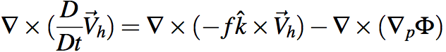
Holy grail of dynamics: get div & ω
Gotta avoid dragging thermo into this via Φ.
Get rid of Φ at any cost. Curl to the rescue!
Ker-CHING!
We are Masters of the Universe with our sexy vector identities!
The grail is in the bag!
Notes:
\nabla \times (\frac{D}{Dt} \vec V_h) = \nabla \times (-f \hat k \times \vec V_h) - \nabla \times (\nabla_p \Phi)

Slide 6
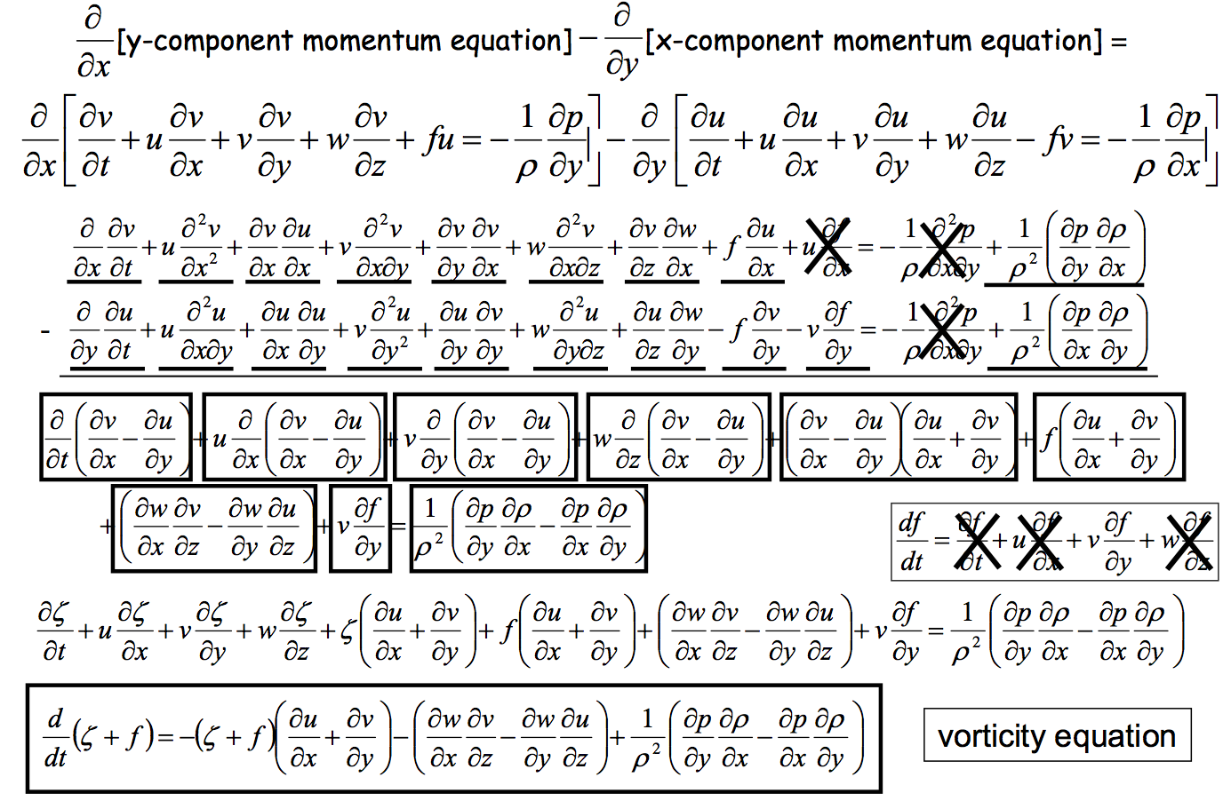
Heh heh ... did I say "any cost"... ? gulp
Can we scrape back some of these cobwebs?
Wait a sec, what's this??

Slide 7
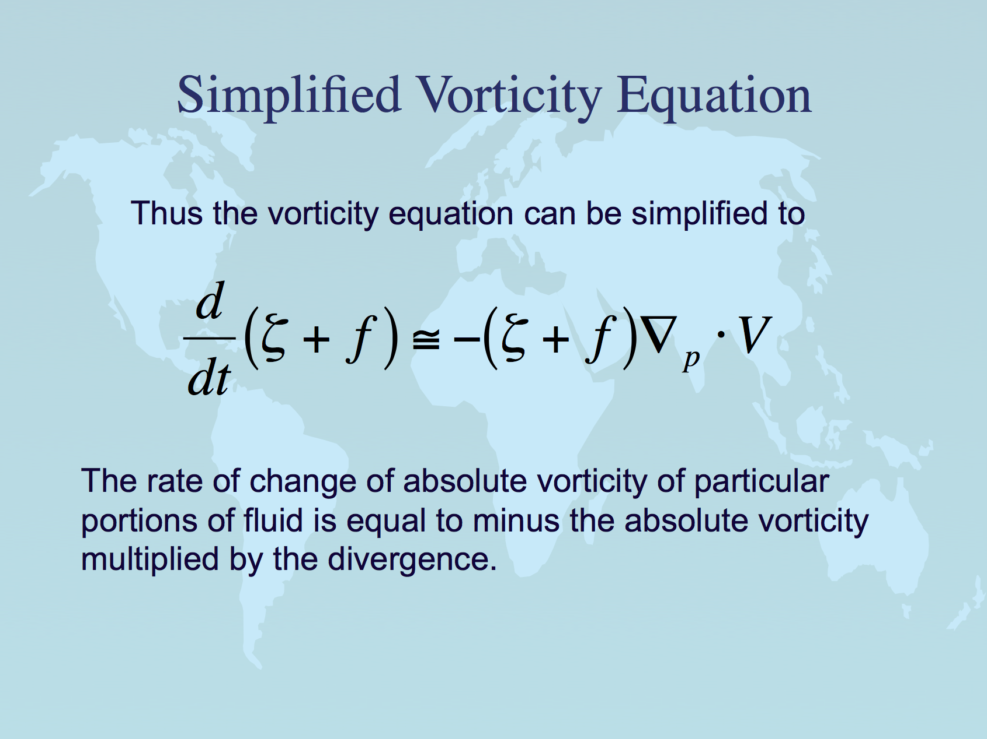
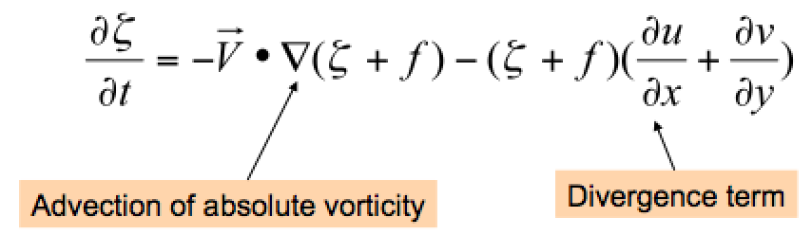
Same equation in Eulerian (local rate of change with time) form.
Lackmann Eq. 1.51

Slide 8
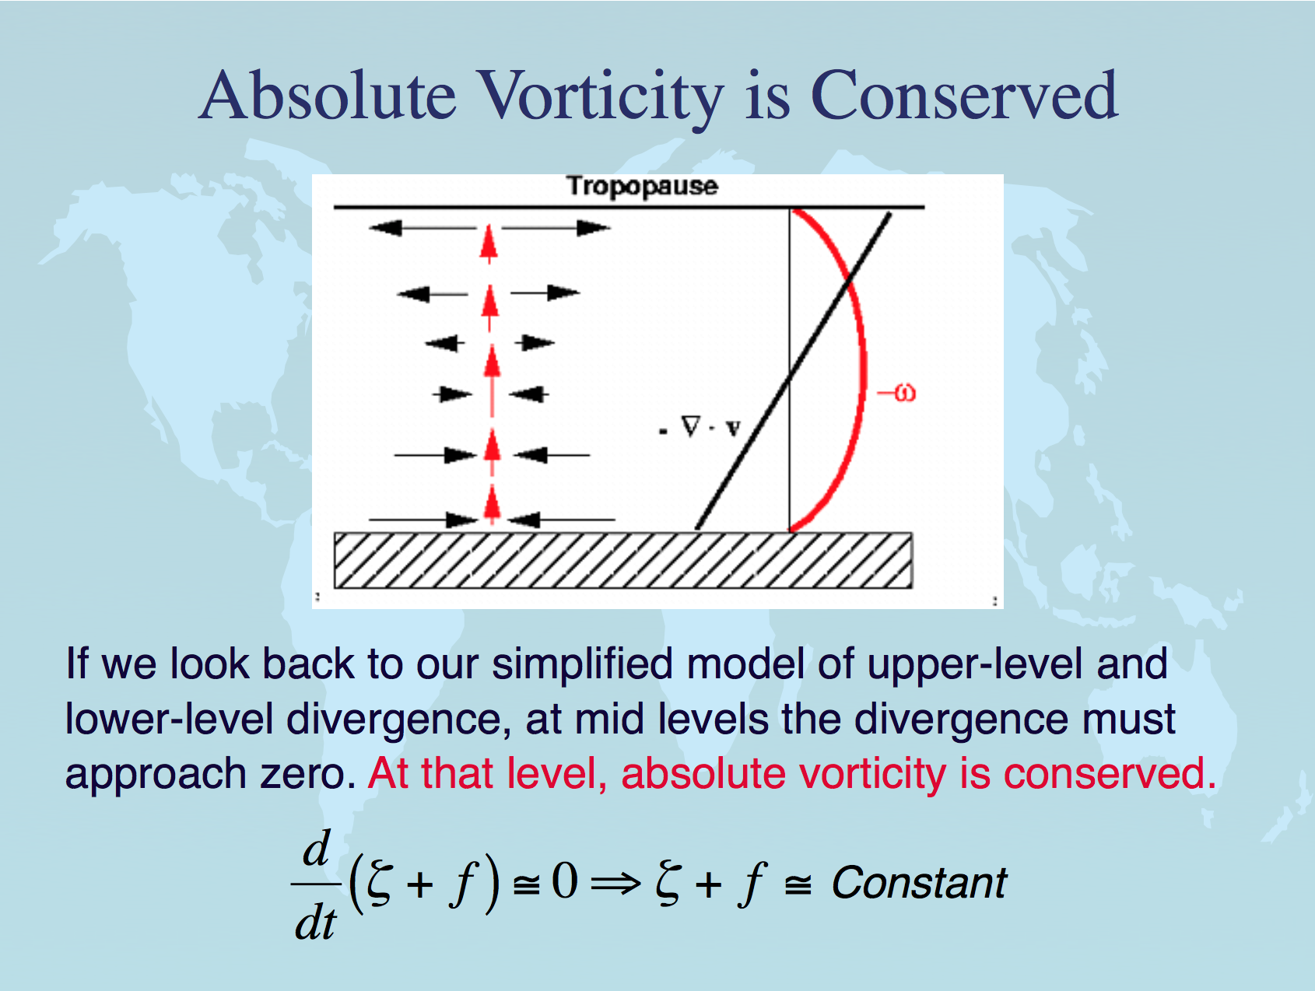
almost,
at midlevels
especially

Slide 9
Ignoring the divergence term... for now...
We will return to it when we define "potential vorticity" …
Same eqn.
←(BVE) →

Slide 10
Conservation of absolute vorticity: how?
When air moves north or south, it tends to conserve its absolute vorticity -- or in other words it converts planetary to relative vorticity. How?
Consider equatorward motion of a disc of fluid.
The initially high f = ζ_{plan} is converted to ζ_{rel}. How?
Physically, the Coriolis force fv is a little bit stronger on its poleward edge (where f is bigger) than on its equatorward edge. This imparts a cyclonic torque on the disk of fluid as it moves southward.
fv
v
All v winds the same, as the disk
moves southward as a unit →
(an eastward PGF must balance the mean Coriolis force, to keep the air flowing southward)
v
fv
v
v
Notes:
\frac {D\zeta_{abs}} {Dt} \simeq 0
\frac {\partial \zeta_{abs}} {\partial t} \simeq -\vec V \cdot \vec \nabla_p \zeta_{abs} - \omega \frac {\partial \zeta_{abs}} {\partial p}

Slide 11
Relative, planetary, and absolute vorticity
absolute = (relative + planetary): ζ_{abs}= ζ_{rel} + ζ_{plan}
planetary vorticity ζ_{plan} = f (aka the “Coriolis parameter”)
f = 2Ω cos(λατιτυδε)
Ω = (2π radians)/(1 day) since the Earth turns once a day
At 40N, f = 10⁻⁴ s⁻¹
Notes:
\frac {D\zeta_{abs}} {Dt} \simeq 0
\frac {\partial \zeta_{abs}} {\partial t} \simeq -\vec V \cdot \vec \nabla_p \zeta_{abs} - \omega \frac {\partial \zeta_{abs}} {\partial p}

Slide 12
Rossby waves: derive their speed c
Consider a simple westerly flow (constant value of U)
Sinusoidal wave pattern in v is superimposed
Wave assumed to propagate eastward at phase speed c
Wavelength = L
north
Height contours
Notes:
2

Slide 13
Compute the vorticity for this flow… only v varies, and only in x
Now, take time derivative of the vorticity….
Notes:
2

Slide 14
Note that
Cancel common terms, and we have
Rearrange to solve for c…
Notes:
2

Slide 15
Rossby Waves: phase vs. group velocity
this c is phase velocity
Rossby wave packet energy moves at the GROUP velocity: eastward instead of westward, for Rossby waves.
Note!! →
1
Notes:
2

Slide 16
Rossby Wave Recap
Physically, how can we understand tendency for Rossby waves to propagate westward relative to the flow?
This is related to the “beta-effect”, motion related to the advection of planetary vorticity (the fact that f changes with latitude)
West of trough axis, in northerly flow, larger f advected : trough “built” there
West of ridge axis, in southerly flow, smaller f advected: ridge “built” there
north
Result: whole pattern propagates westward against vorticity advection, which acts to push pattern eastward
Notes:
2

Slide 17
Rossby wave group velocity energetics (downstream development):
Waves here strengthen
Waves here weaken
Energy flux

Slide 18
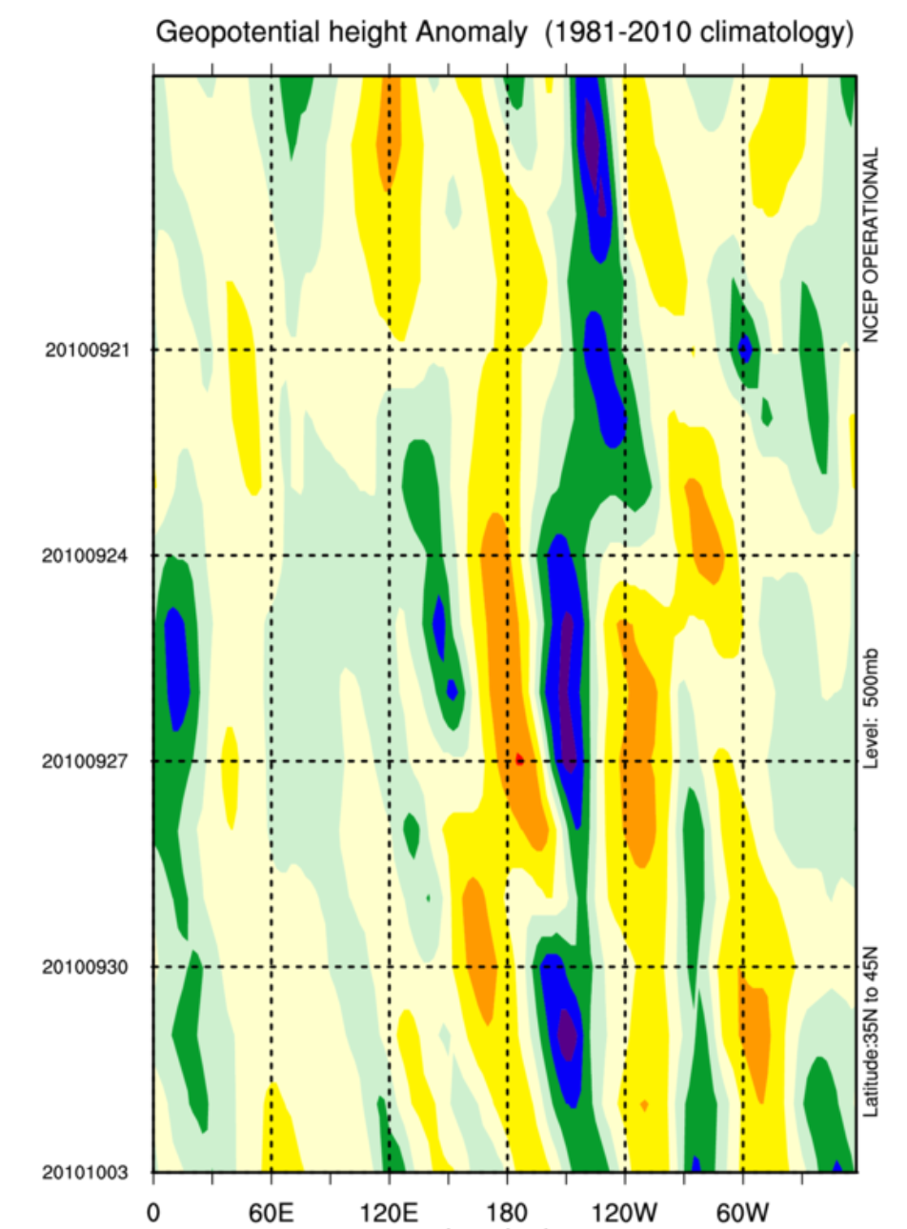
Example:
Z’(lon, time)
diagram
phase velocity near zero (almost stationary waves,) like in the river
time→
group or energy speed: fast eastward

Slide 19
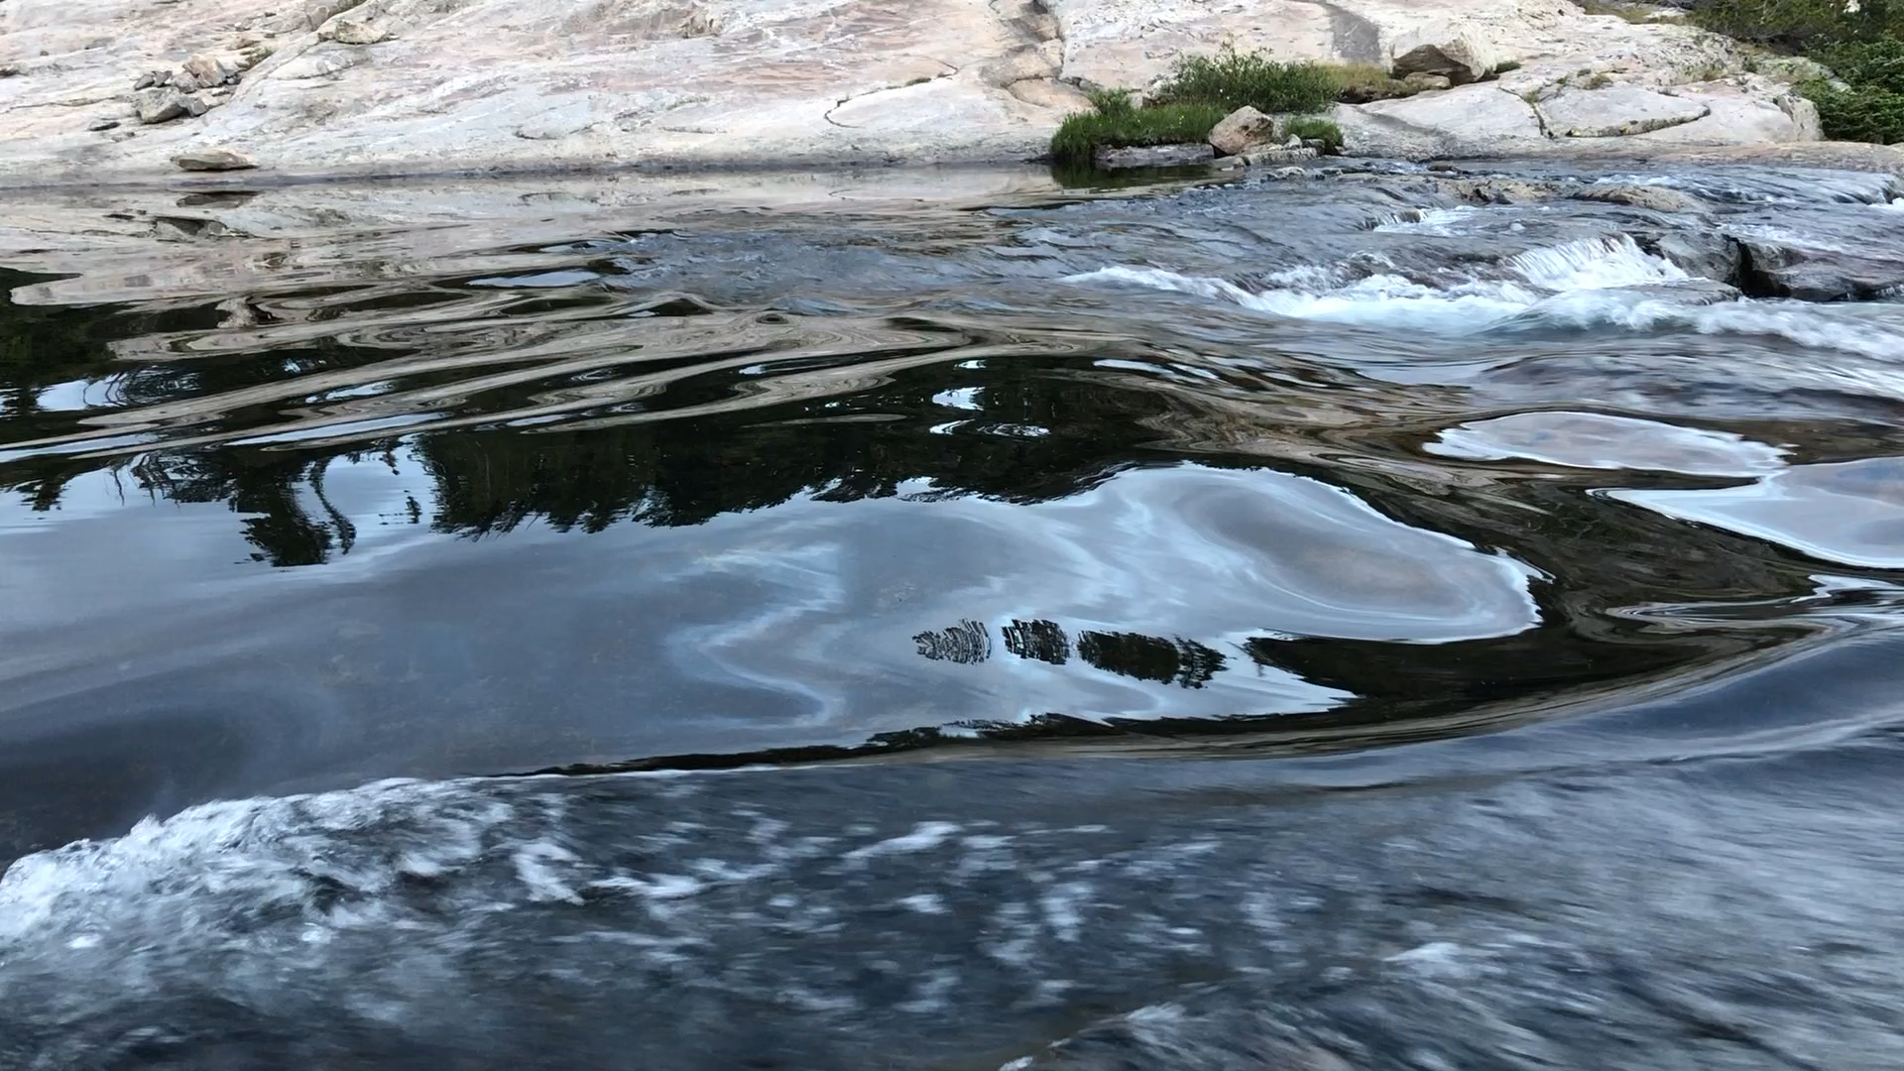

Slide 20
midlatitude Rossby waves review
Wirth, V., M. Riemer, E.K. Chang, and O. Martius, 2018: Rossby Wave Packets on the Midlatitude Waveguide—A Review.
Mon. Wea. Rev., 146, 1965–2001
https://doi.org/10.1175/MWR-D-16-0483.1

Slide 21
Edit the dates: time-lon book plot
https://psl.noaa.gov/cgi-bin/hovmoller/timeplot.ncl.pl?var=hgt&level=500&mon1=9&mon2=10&day1=1&day2=11&yr1=2022&yr2=2022&datatype=ncepreanalysis&type=anom&fxdlon=no&postscript=no&lon1=&lon2=&lat1=35&lat2=45&cint=&lowr=&highr=&size=100&color=Default&Submit=Create+Plot

